Slide 1
Section 9.8
Infinite Series: “Maclaurin and Taylor Series; Power Series”

Slide 2
All graphics are attributed to:
Calculus,10/E by Howard Anton, Irl Bivens, and Stephen Davis
Copyright © 2009 by John Wiley & Sons, Inc. All rights reserved.”

Slide 3

Introduction
In the last section, the nth Taylor polynomial $p_{n}$(x) at x=$x_{0}$ for a function f was defined so its value and the values of its first n derivatives match those of f at $x_{0}$.
Also, for values of x near $x_{0}$, the values of $p_{n}$(x) appeared to be better and better approximations of f(x) as n increases, and may possibly converge to f(x) as n $→+∞$.

Slide 4
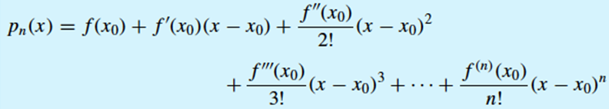
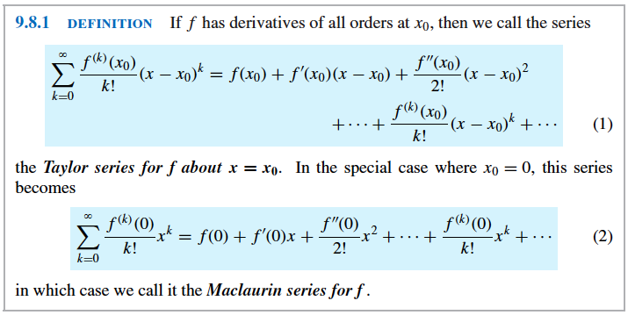

Maclaurin and Taylor Series
If we take the nth Maclaurin polynomial for a function f
and the nth Taylor polynomial for f about x = $x_{0}$,
we can extend them beyond the nth index of summation.

Slide 5

Example of Series vs. Polynomial
Find the Maclaurin series for cos x.
Solution:
Start by finding several derivatives of cos x.
  f(x) = cos x f(0) = cos 0 = 1
  f’(x) = -sin x f’(0) = -sin 0 = 0
  f’’(x) = -cos x f’’(0) = -cos 0 = -1
  f”’(x) = sin x f”’(0) = sin 0 = 0
  and the pattern (0,1,0,-1) continues to repeat for further derivatives at 0.
This gives the Maclaurin polynomials
$p_{2k}\left(x\right)= p_{2k+1}\left(x\right)=1−\frac{x^{2}}{2!}$+ $\frac{x^{4}}{4!}−\frac{x^{6}}{6!}+…+{\left(−1\right)}^{k}\frac{x^{2k}}{\left(2k\right)!} (k=0,1,2,…)$.
Therefore, the Maclaurin series for cos x is
$\sum_{k=0}^{∞}{{\left(−1\right)}^{k}\frac{x^{2k}}{\left(2k\right)!}= }$ $1−\frac{x^{2}}{2!}$+ $\frac{x^{4}}{4!}−\frac{x^{6}}{6!}+…+{\left(−1\right)}^{k}\frac{x^{2k}}{\left(2k\right)!}+…$

Slide 6

Power Series in x
Maclaurin and Taylor series are different than the series we worked with in sections 9.3-9.6.
Instead of constants, they have variables in the series.
These are examples of power series.
If we use x as a variable, we get a power series in x:
$$\sum_{k=0}^{∞}{c_{k}x^{k}=c_{0}+c_{1}x+c_{2}x^{2}}+…+c_{k}x^{k}+…$$

Slide 7

Examples of Power Series in x
$\sum_{k=0}^{∞}{x^{k}=1+x+x^{2}+x^{3}+…}$ Maclaurin series for $\frac{1}{1−x}$
$\sum_{k=0}^{∞}{\frac{x^{k}}{k!}=1+x+\frac{x^{2}}{2!}+\frac{x^{3}}{3!}+…}$ Maclaurin series for $e^{x}$
$\sum_{k=0}^{∞}{{(−1)}^{k}\frac{x^{2k}}{(2k)!}=1−\frac{x^{2}}{2!}+\frac{x^{4}}{4!}+…}$ Maclaurin series for cos x
NOTE: Every Maclaurin series is a power series in x.

Slide 8

Radius and Interval of Convergence
If a numerical value is substituted for x in a power series $\sum{c_{k}x^{k}}$, then the resulting series of numbers may either converge or diverge.
We need to determine the set of x-values for which a given power series converges.
This is called its convergence set.
NOTE: Every power series in x converges at x=0, since substituting 0 into the Maclaurin series gives $c_{0}+0+0+0+…+0+…$ whose sum is $c_{0}$. For some, x=0 will be the only number in the convergence set.

Slide 9
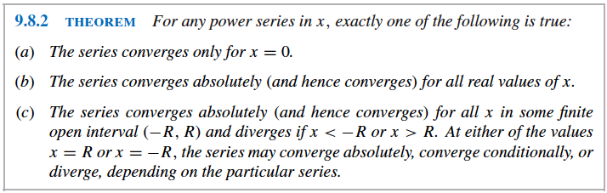
Radius and Interval of Convergence Theorem
This theorem states that the convergence set for a power series in x is always an interval centered at x=0.
For this reason (“centered”), the convergence set of a power series in x is called the interval of convergence.

Slide 10
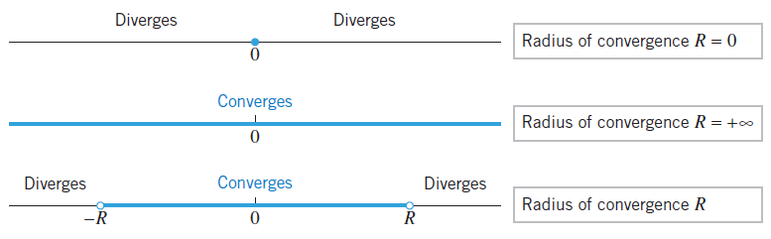

Radius of Convergence
When the convergence set is only x=0, we say that the series has radius of convergence of 0.
When the convergence set is $(−∞,+∞)$, we say that the series has radius of convergence $+∞$.
When the convergence set is between –R and R, we say that the series has radius of convergence R.

Slide 11

Finding the Interval of Convergence
The usual procedure for finding the interval of convergence of a power series is to apply the ratio test for absolute convergence.
Example: Find the interval of convergence and radius of convergence of$\sum_{k=0}^{∞}{\frac{x^{k}}{k!}}$.
Solution:
Apply the ratio test for absolute convergence
$ρ=\lim_{k→+∞}\left|\frac{u_{k+1}}{u_{k}}\right|$=$\lim_{k→+∞}\left|\frac{x^{k+1}}{\left(k+1\right)!}∗\frac{k!}{x^{k}}\right|$=$\lim_{k→+∞}\left|\frac{x}{k+1}\right|$=0<1
since zero is always less than one for all values of x, the series converges for all x, the interval of convergence is $(−∞,+∞$) and the radius of convergence is R = $+∞$.

Slide 12

Another Example of Finding the Interval and Radius of Convergence
We are going to do the ratio test for absolute convergence on $\sum_{k=0}^{∞}{\frac{{(−1)}^{k}x^{k}}{3^{k}(k+1)}}.$ Therefore, we should notice that $\left|{(−1)}^{k}\right|$= $\left|{(−1)}^{k+1}\right|$=1.
This gives $ρ=\lim_{k→+∞}\left|\frac{u_{k+1}}{u_{k}}\right|$=$\lim_{k→+∞}\left|\frac{x^{k+1}}{3^{k+1}\left(k+2\right)}∗\frac{3^{k}(k+1)}{x^{k}}\right|$
=$\lim_{k→+∞}\left|\frac{x^{k}∗x^{1}}{3^{k}∗3^{1}\left(k+2\right)}∗\frac{3^{k}(k+1)}{x^{k}}\right|$=$\lim_{k→+∞}\left|\frac{x}{3\left(k+2\right)}∗\frac{ (k+1)}{1}\right|$
=$\lim_{k→+∞}\left[\frac{\left|x\right|}{3}\right]∗\frac{ (k+1)}{(k+2)}$ =$\frac{\left|x\right|}{3}∗\lim_{k→+∞}\frac{1+\frac{1}{k}}{1+\frac{2}{k}}= \frac{\left|x\right|}{3}$ * 1 = $\frac{\left|x\right|}{3}$<1 when $\left|x\right|<3$ which is where the series absolutely converges.
$ρ$>1 when $\left|x\right|>3$ which is where the series diverges.
The radius of convergence is 3 and we must test endpoints to determine the interval of convergence.

Slide 13

Example continued
The only thing left to find out is whether the series converges or diverges at x = 3 and x = -3, so we must test those endpoints:
  When you substitute x = 3 into the series $\sum_{k=0}^{∞}{\frac{{(−1)}^{k}x^{k}}{3^{k}(k+1)}}$, $\sum_{k=0}^{∞}{\frac{{(−1)}^{k}3^{k}}{3^{k}(k+1)}}$is the result which simplifies to $\sum_{k=0}^{∞}{\frac{{(−1)}^{k}}{ (k+1)}}$ and that equals 1 - $\frac{1}{2}$ + $\frac{1}{3}$ - $\frac{1}{4}$ + … which is the alternating harmonic series and it converges and so does the series when x = 3.
  When you substitute x = -3 into the series $\sum_{k=0}^{∞}{\frac{{(−1)}^{k}x^{k}}{3^{k}(k+1)}}$, $\sum_{k=0}^{∞}{\frac{{(−1)}^{k}({−3)}^{k}}{3^{k}(k+1)}}$is the result which simplifies to $\sum_{k=0}^{∞}{\frac{{{(−1)}^{k}∗(−1)}^{k }}{ (k+1)}}$ = $\sum_{k=0}^{∞}{\frac{1}{ (k+1)}}$ and that equals 1 + $\frac{1}{2}$ + $+\frac{1}{4}$ + … which is the harmonic series and it diverges and so does the series when x = -3.
  Therefore, the interval of convergence is (-3,3] or -3<x≤3.
Please do NOT forget to check the endpoints. It is a very common mistake on the AP exam.

Slide 14
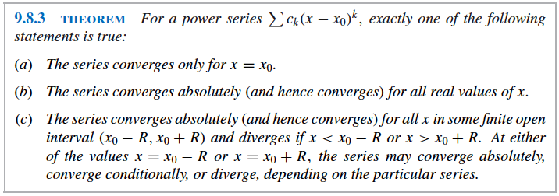


Power Series in x - $x_{0}$
From the Maclaurin series we can write a “power series in x - $x_{0}$” in Sigma notation:
$\sum_{k=0}^{∞}{\frac{f^{\left(k\right)}\left(x_{0}\right)}{k!}{(x −x_{0})}^{k}}$

Slide 15
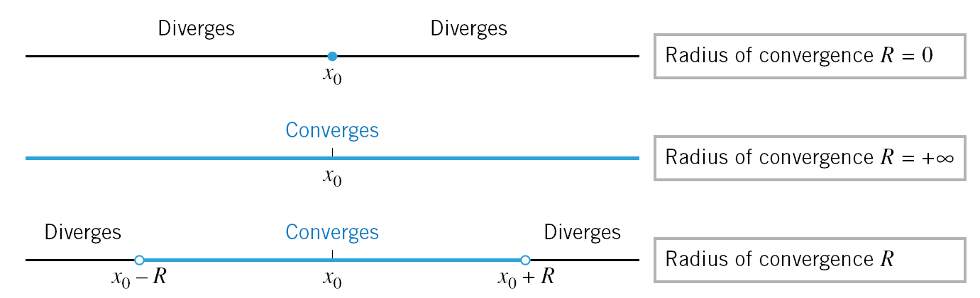

Visual Demonstration of Theorem 9.8.3
These results are similar to those on slide #10 for Maclaurin series, but those are centered about 0 instead of $x_{0}.$

Slide 16


Interval of Convergence example for a Power Series in $x −x_{0}$
Find the interval of convergence and radius of convergence of the series $\sum_{k=1}^{∞}{\frac{({x−5)}^{k}}{k^{2}}}.$
Solution: apply the ratio test for absolute convergence.
This gives $ρ=\lim_{k→+∞}\left|\frac{u_{k+1}}{u_{k}}\right|$=$\lim_{k→+∞}\left|\frac{({x−5)}^{k+1}}{{(k+1)}^{2}}∗\frac{k^{2}}{{(x−5)}^{k}}\right|$
=$\lim_{k→+∞}\left[\left|x−5\right|{\left(\frac{k}{k+1}\right)}^{2}\right]$ = $\left|x−5\right|$ $\lim_{k→+∞}$ ${\left(\frac{1}{1+\frac{1}{k}}\right)}^{2}$ =$\left|x−5\right|$*1
$\left|x−5\right|$ <1
-1<x-5<1
+5 +5 +5
4 < x < 6 Therefore, the radius of convergence is 1 since 4 and 6 are both 1 from 5 and we must test the endpoints to determine the interval of convergence.

Slide 17

Test Endpoints from example #4
The only thing left to find out is whether the series converges or diverges at x = 4 and x = 6, so we must test those endpoints:
  When you substitute x = 4 into the series$\sum_{k=1}^{∞}{\frac{({x−5)}^{k}}{k^{2}}}$,$\sum_{k=1}^{∞}{\frac{({−1)}^{k}}{k^{2}}}$is the result which converges absolutely since it is a p-series with p=2 and 2>1 so the series converges when x = 4.
  When you substitute x = 6 into the series $\sum_{k=1}^{∞}{\frac{({x−5)}^{k}}{k^{2}}}$,$\sum_{k=1}^{∞}{\frac{({1)}^{k}}{k^{2}}}$is the result which converges since it is a p-series with p=2 and 2>1 so the series converges when x = 6.
  Therefore, the interval of convergence is [4,6] or 4 ≤ x ≤6.
Please do NOT forget to check the endpoints. It is a very common mistake on the AP exam.

Slide 18
Other
You may read about functions defined by power series leading to Bessel functions in honor of the German mathematician and astronomer Friedrich Wilhelm Bessel (1784-1846) if you are interested, but they are not on the AP or IB exam.

Slide 19

View from our hotel in Ixtapa, Mexico

